Slide 1





casa0016
Multifunctional Wardrobe Dehumidification
Pre：Zinan ye
Date：27/11/2024
Notes:
Hello everyone,
Today, I am excited to present my project, the Multifunctional Wardrobe Dehumidification Assistant. My presentation will cover four key sections. Let me begin by explaining the inspiration behind this project.

Slide 2
Contents
01-
Ideas
why？
02-
Design
What？
03-
Show
How?
04-
Q&A
Question

Slide 3

01
Origin of Inspiration
Why do this

Slide 4
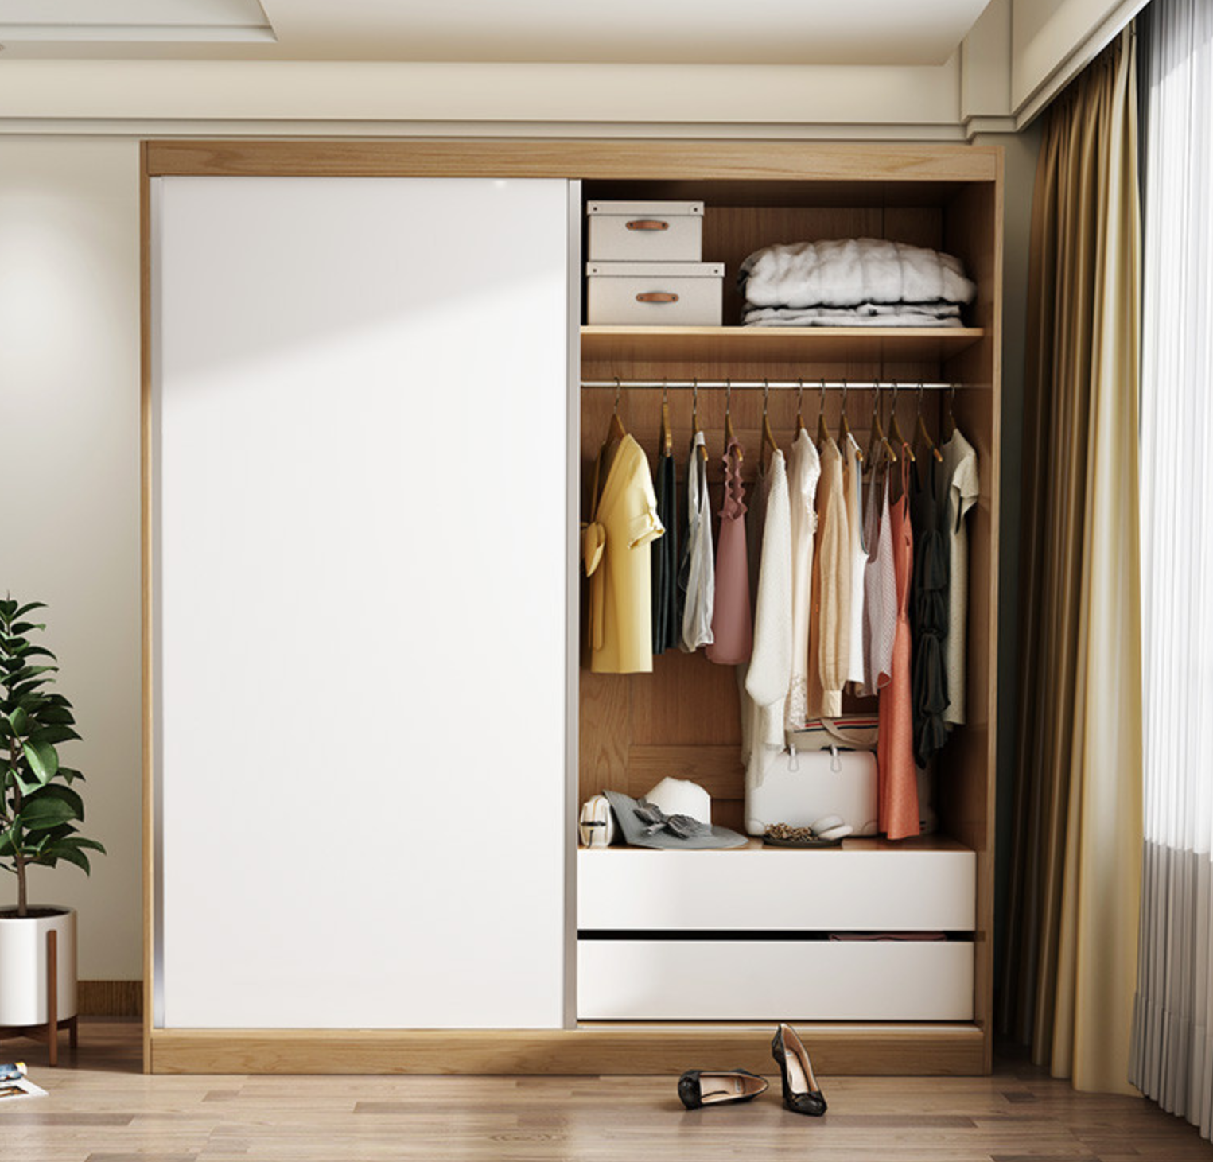
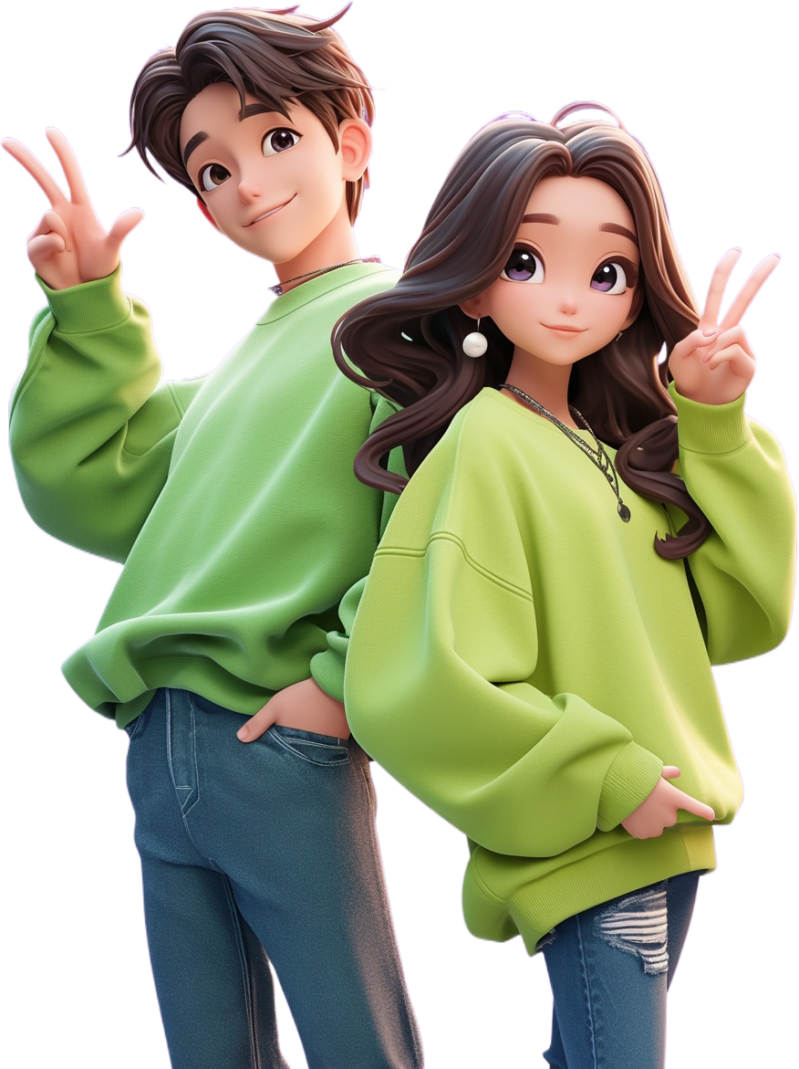
Background
Areas with more rainy seasons have relatively humid air, which is not conducive to clothing preservation
Humid region
Rainy days
Bad for clothes
01
02
03
Notes:
Inspiration
In my hometown, where the climate is particularly humid, continuous rainy days often result in clothes in wardrobes feeling damp. Upon arriving in the UK, I noticed that the humidity in rooms—especially inside wardrobes—is significantly higher than in other areas like the living room. High humidity can damage clothing and make them unsuitable for long-term storage. To address this issue, I decided to design a smart dehumidification assistant specifically for wardrobes. Of course, this device can also be used in other locations with similar humidity concerns.

Slide 5

02
Design&Build
Design Principle

Slide 6
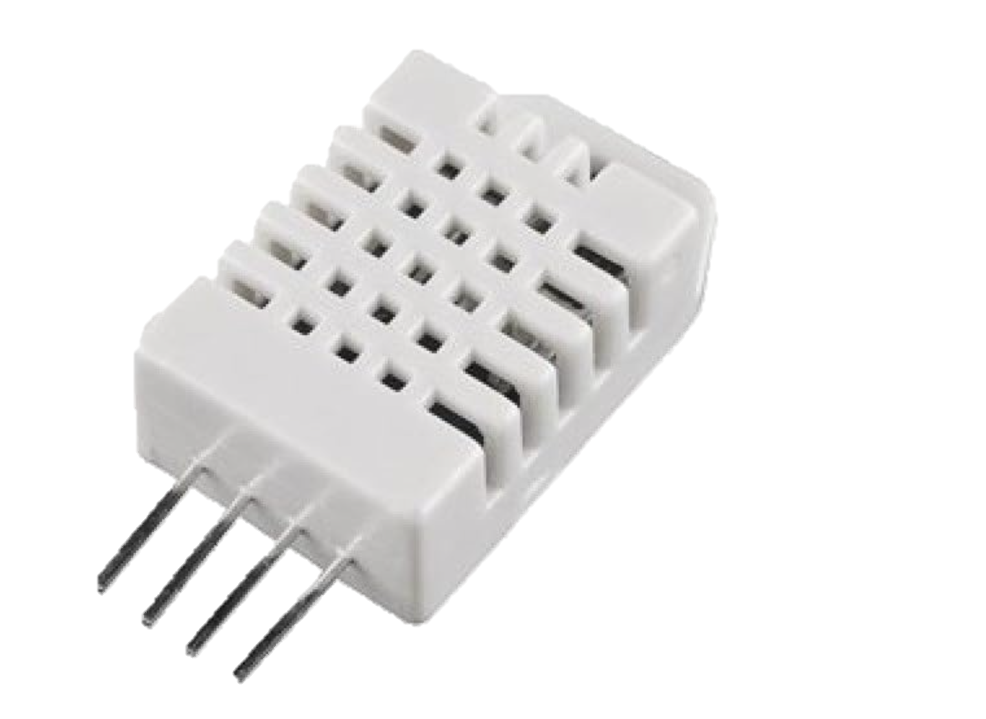
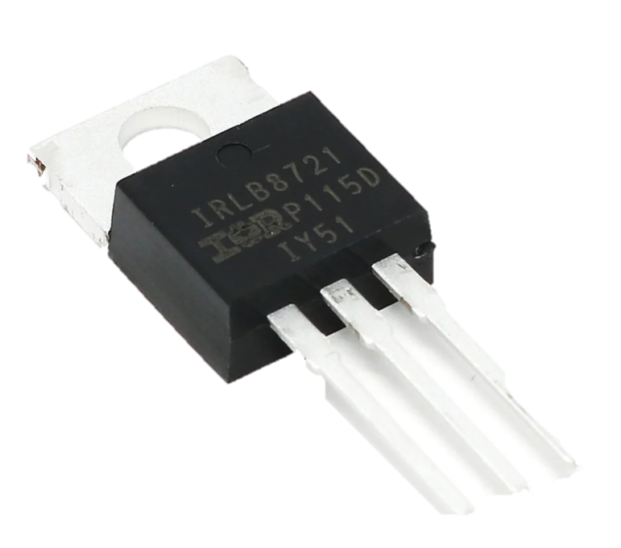
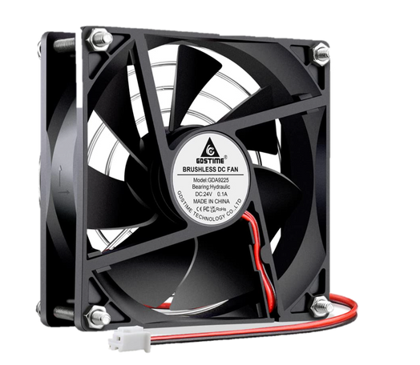
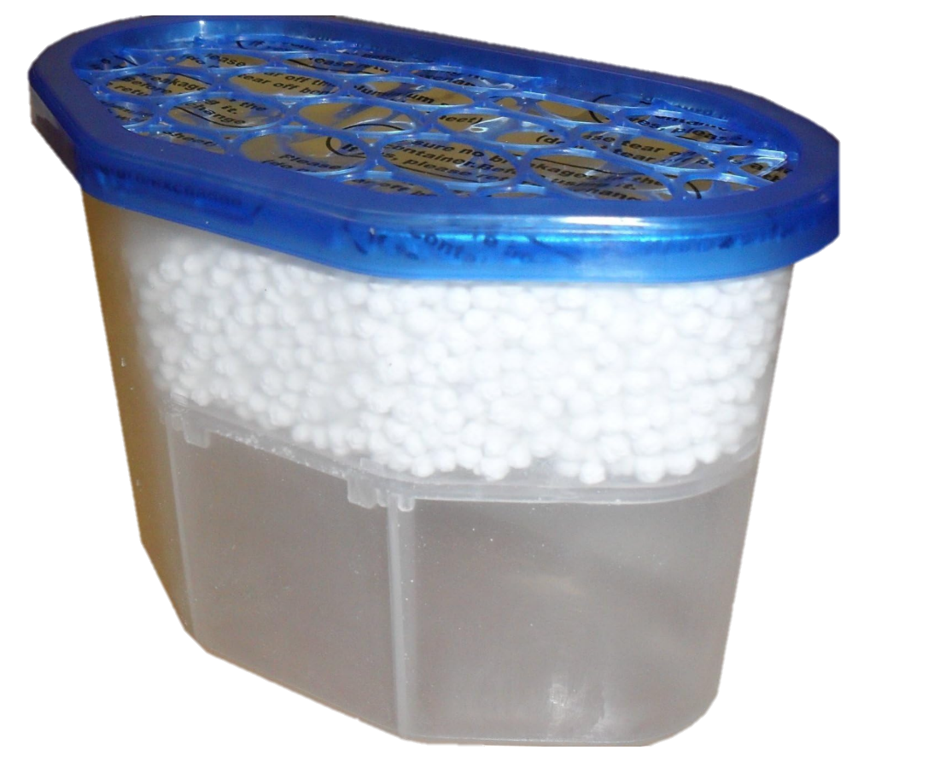
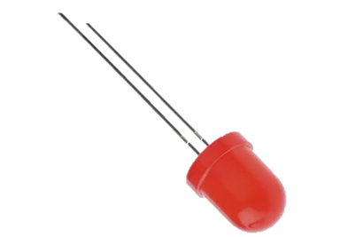
Components
Electronic components
Other materials
Output
⬆ LOGIC N-Channel MOSFET
⬅ LED lights
⬅servo Fan
Dht22 Temperature &Humidity sensor→
Interior Dehumidifiers Clear
01
02
Notes:
Components
Now, let me introduce the core components of this project:
Mainboard: I used the Arduino R3 microcontroller as the central processing unit.
Sensor: The DHT22 temperature and humidity sensor, which monitors environmental humidity.
Output Devices: Three LED lights—red, yellow, and blue—and a servo fan.
Additional Tool: A calcium chloride-based moisture absorption box, which helps absorb water from the air. The fan enhances this process by improving airflow.
These components work together to form a simple yet effective system for managing humidity.

Slide 7
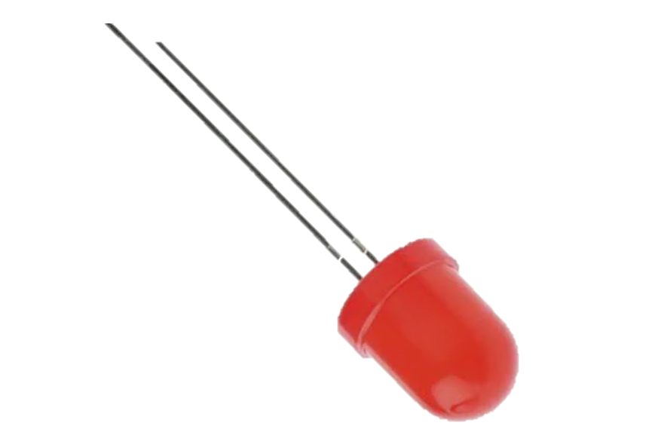
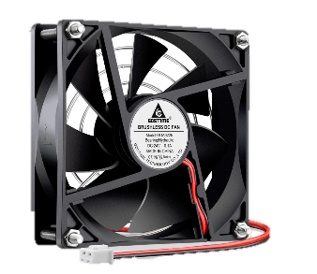

Design Principles
A red LED lights up humidity too high, fan speed up dehumidification.
A yellow LED a warning level, moderate humidity needs attention.
A blue LED signals safe humidity levels.
DHT22 sensor measures the humidity
01
02
03
Notes:
Design Principles
Here’s how the system works:
First, the DHT22 sensor measures the humidity. Based on the readings:
A red LED lights up if the humidity is too high, and the fan is activated to speed up dehumidification.
A yellow LED indicates a warning level, suggesting moderate humidity that needs attention.
A blue LED signals safe humidity levels.
This straightforward design allows the system to react dynamically to different humidity levels, ensuring optimal wardrobe conditions.

Slide 8
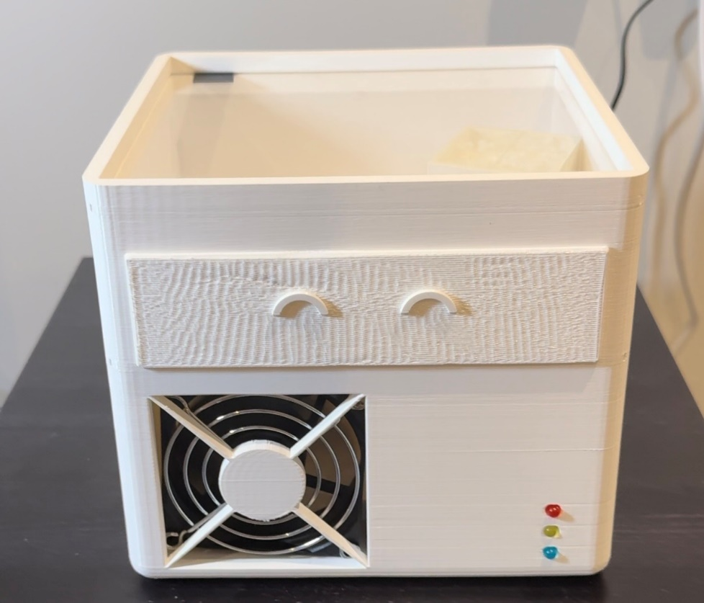
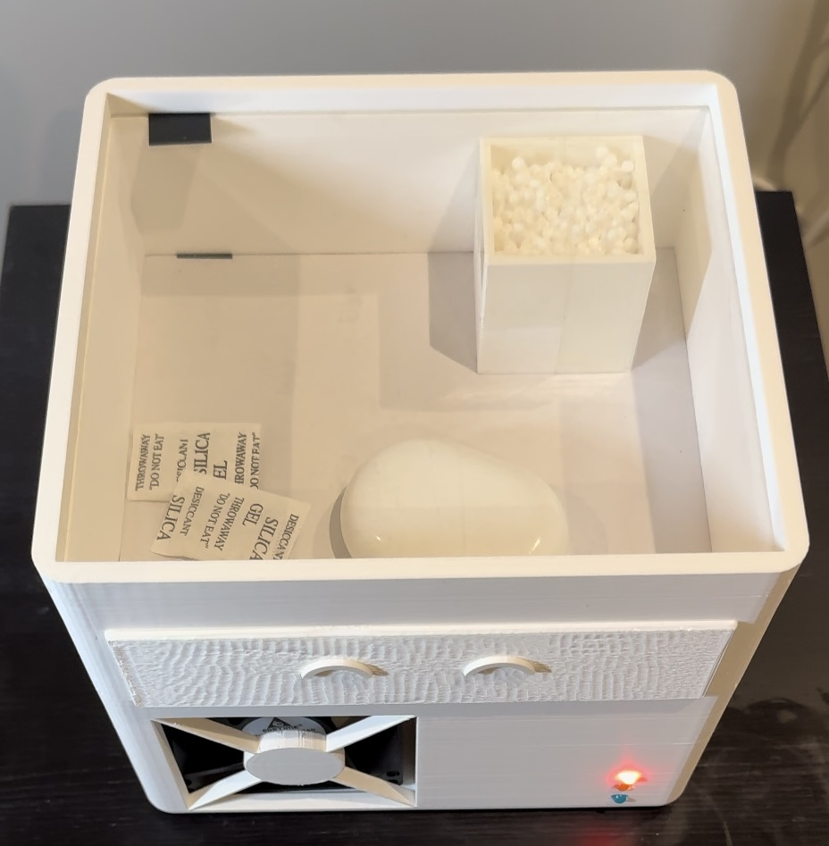
Design Concept
Function1
Fucntion2
serve as a dehumidification assistant,
Reducing humidity levels inside the wardrobe.
Provides a dry space for storing small items that require a low-humidity environment
03
Notes:
My design incorporates two primary functions.
The first is to serve as a dehumidification assistant, reducing humidity levels inside the wardrobe. The second function is a dedicated drying compartment located in the top section of the device. This compartment provides a dry space for storing small items that require a low-humidity environment.

Slide 9
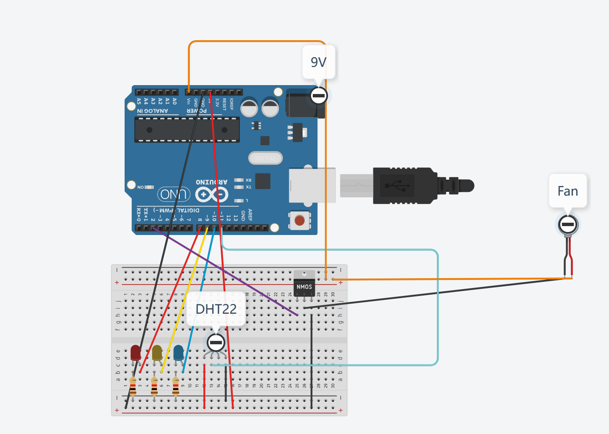
Problems
Supply power to Fan
Circuit 1 powers the sensor and LEDs using a 5V supply.
Circuit 2 powers the fan directly through the DC input to Vin pin.
share a common ground to ensure stable operation.
03
Notes:
Challenges and Solutions
One of the main challenges I encountered was that the Arduino’s USB port couldn’t provide enough power for the fan. To address this, I used a 9V servo fan for stronger airflow and redesigned the circuit into two separate systems:
Circuit 1 powers the sensor and LEDs using a 5V supply.
Circuit 2 powers the fan directly through the DC input and Vin pin.
To control the fan, I used a 60V N-Channel MOSFET, which regulates the fan’s power based on the Arduino’s logic signals. Importantly, both circuits share a common ground to ensure stable operation.
This approach effectively solved the power issue, enabling the fan and LEDs to function without interruptions.

Slide 10

03
Demo Show
Video & onsite display
Notes:
Conclusion
Finally, I invite you to watch a short demonstration video showcasing how my dehumidification assistant operates and responds to varying humidity levels. Thank you for your attention!

Slide 11
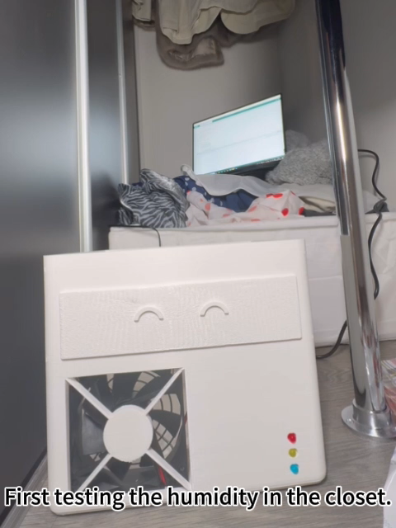
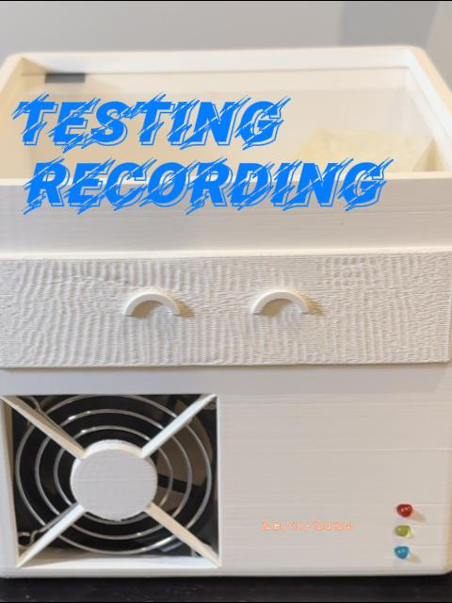
Video show
Github link:TTrista/CASA0016_cw_final (github.com)

Slide 12
THANKS!
THANK YOU FOR WATCHING
Pre：Zinan ye
Date：27/11/2024

Slide 13
04
Q&A

